Slide 1
Digital Photography
This resource is included in TATA’s COVID19 visual art resources collection with appreciation and permission from its creator,
Caz Saunders from Riverside High School, Tasmania. TATA does not have ownership of the IP (Intellectual Property) contained within
the resources shared on this website. TATA acknowledges the generosity of sharing practice that underpins this collaborative resource
sharing space, and ask that any on-sharing of resources acknowledge the originating IP of the Arts/Education professional/s who have contributed this resource, as well as any third party content acknowledged therein.

Slide 2
What makes a strong photo?
Use the Elements of Art:
  Space
  Colour
  Texture
  Line
  Shape

Slide 3
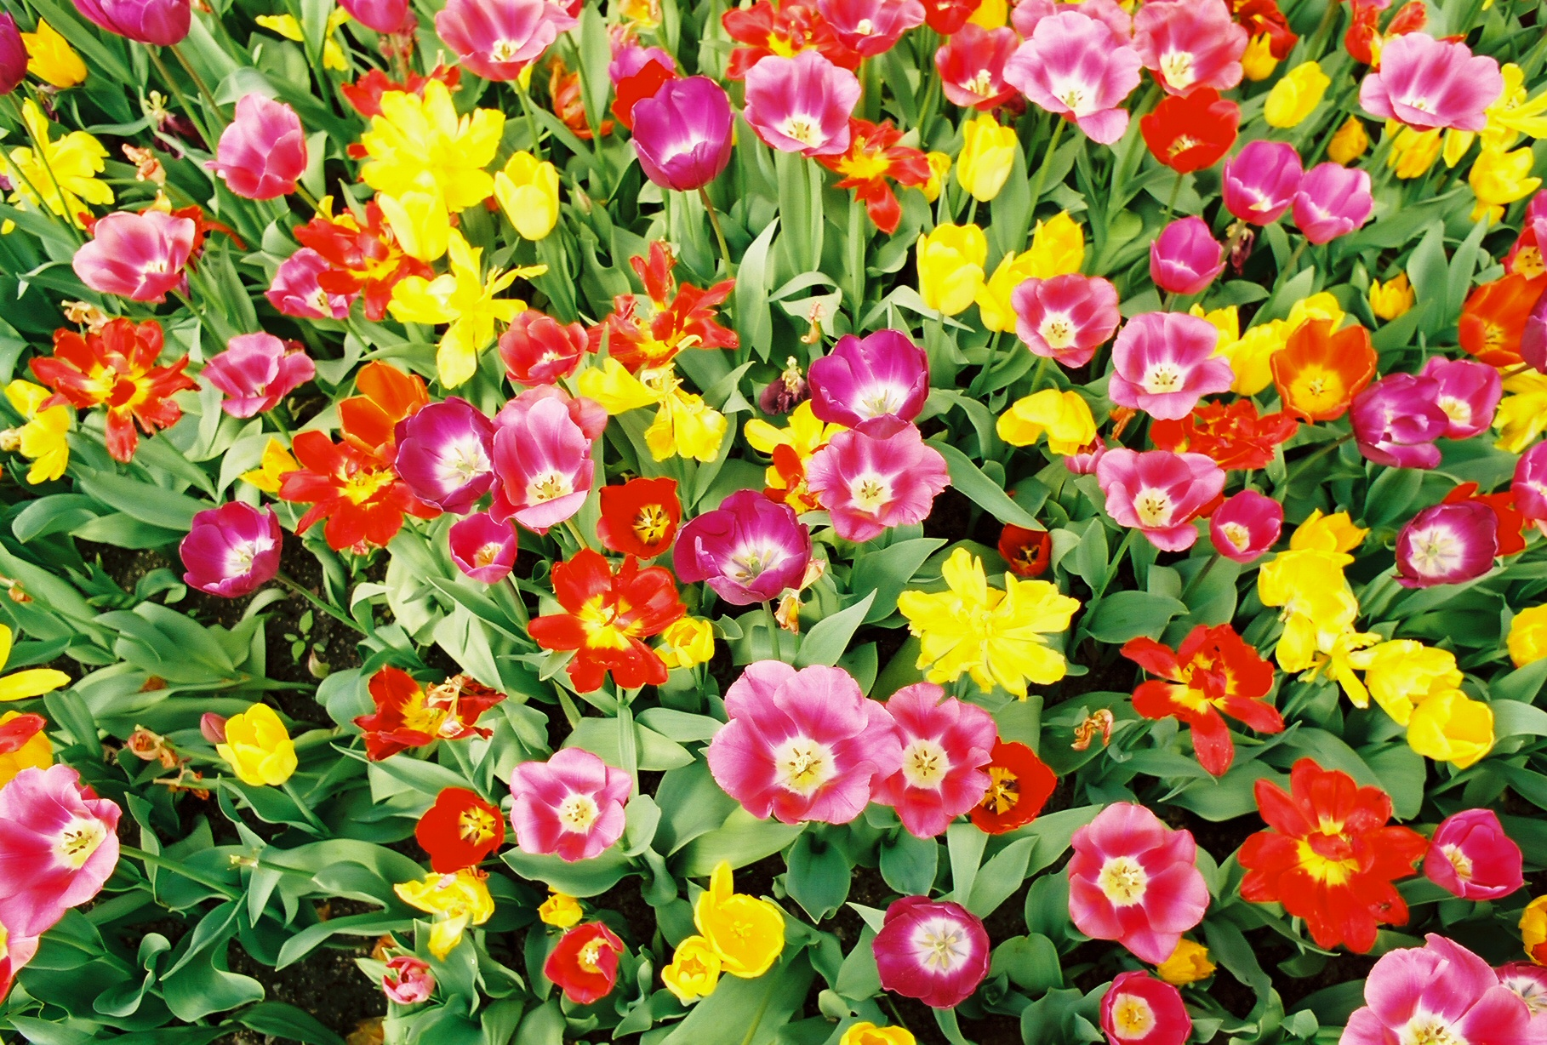
Which Elements of Art are in this photo?

Slide 4
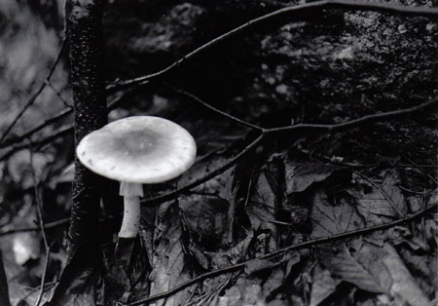
Look for contrast (light vs. dark):

Slide 5
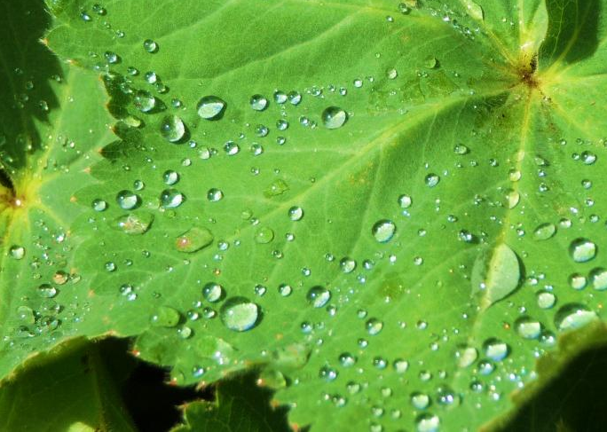
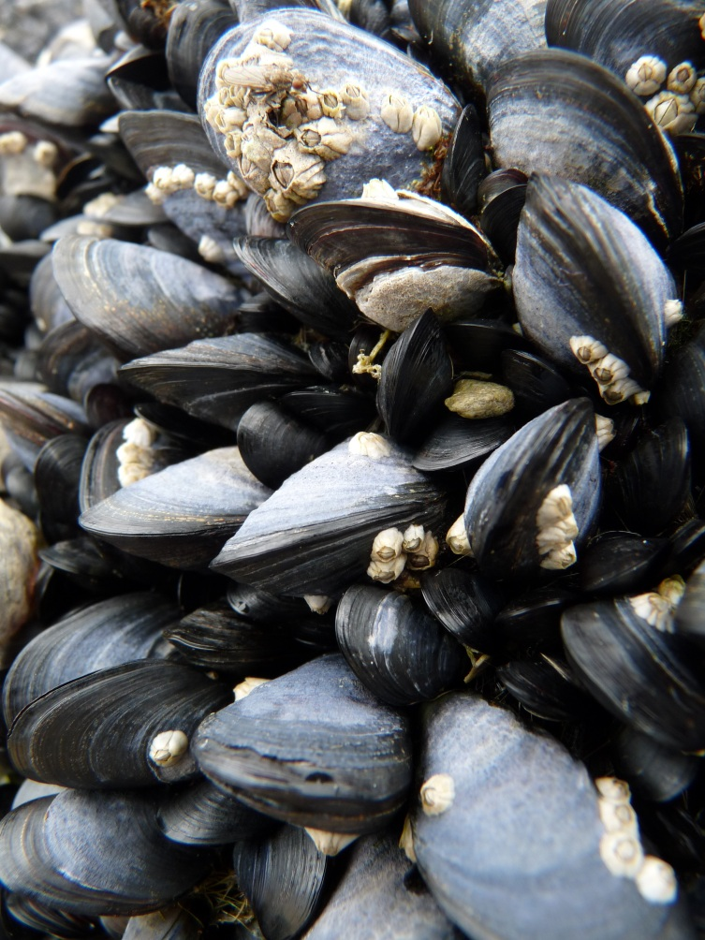
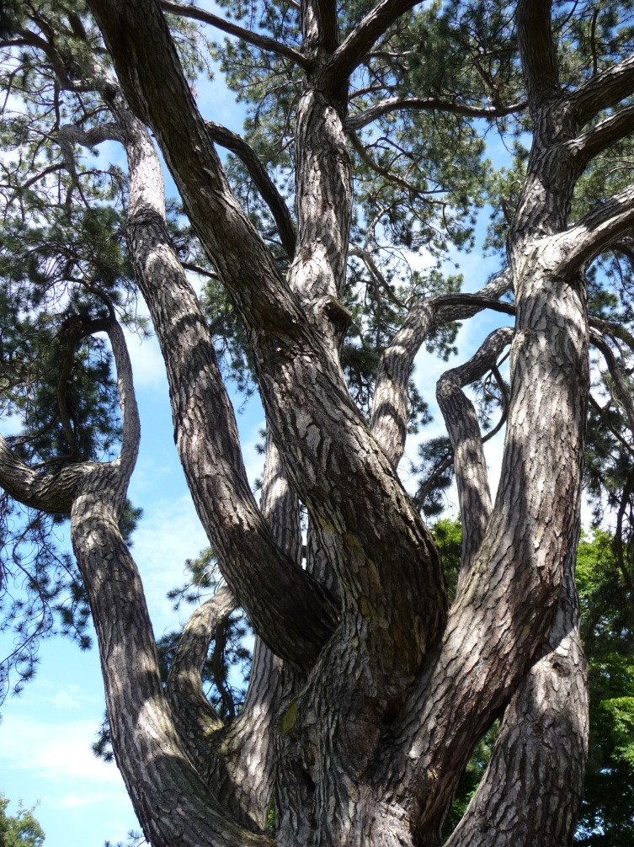
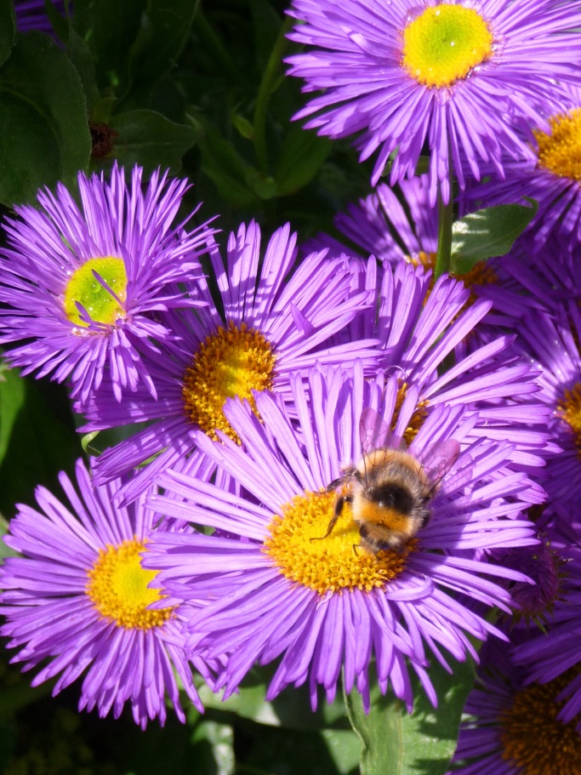
Look for an interesting composition (layout):

Slide 6
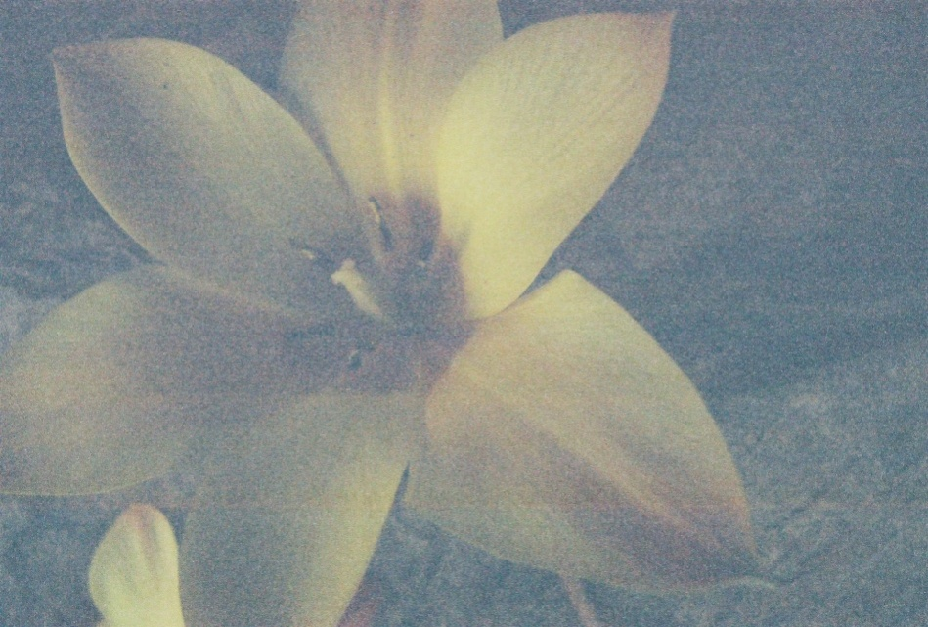
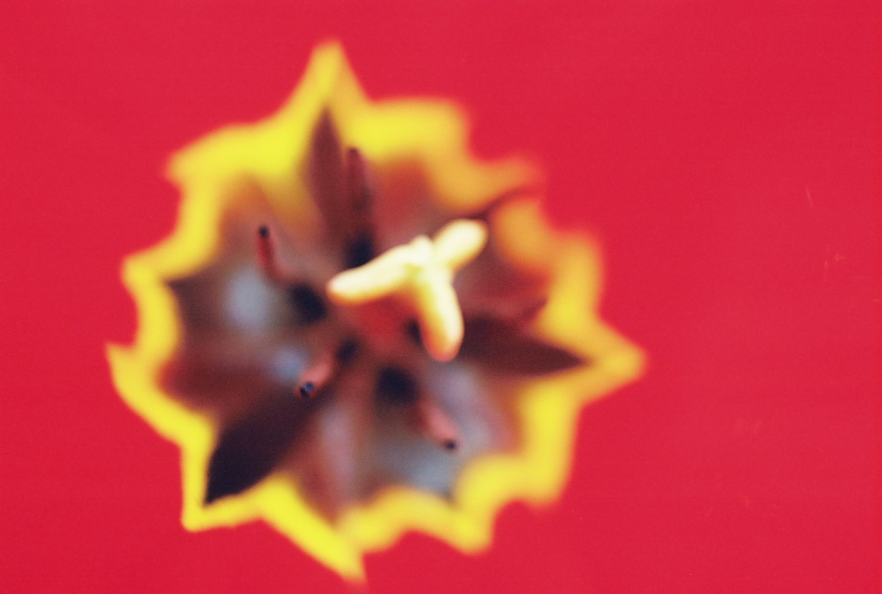
Make sure your photos are clear:
Interesting composition but blurry
Not enough light

Slide 7
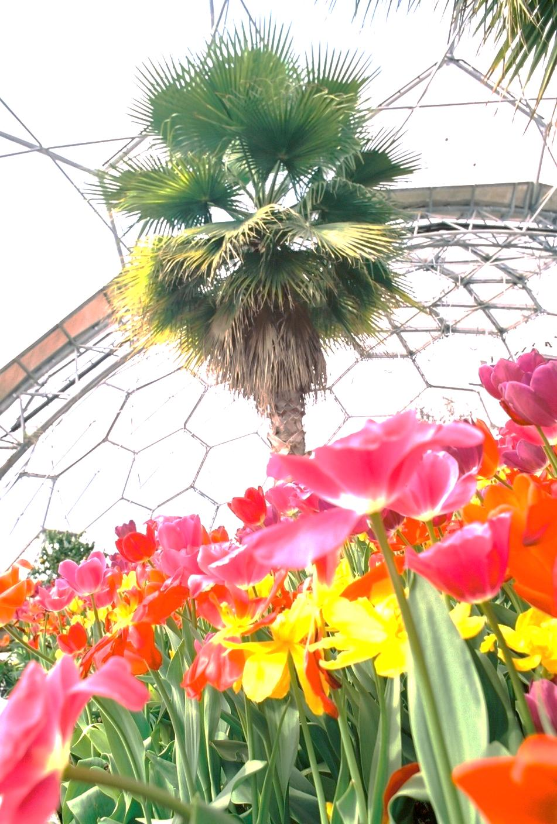
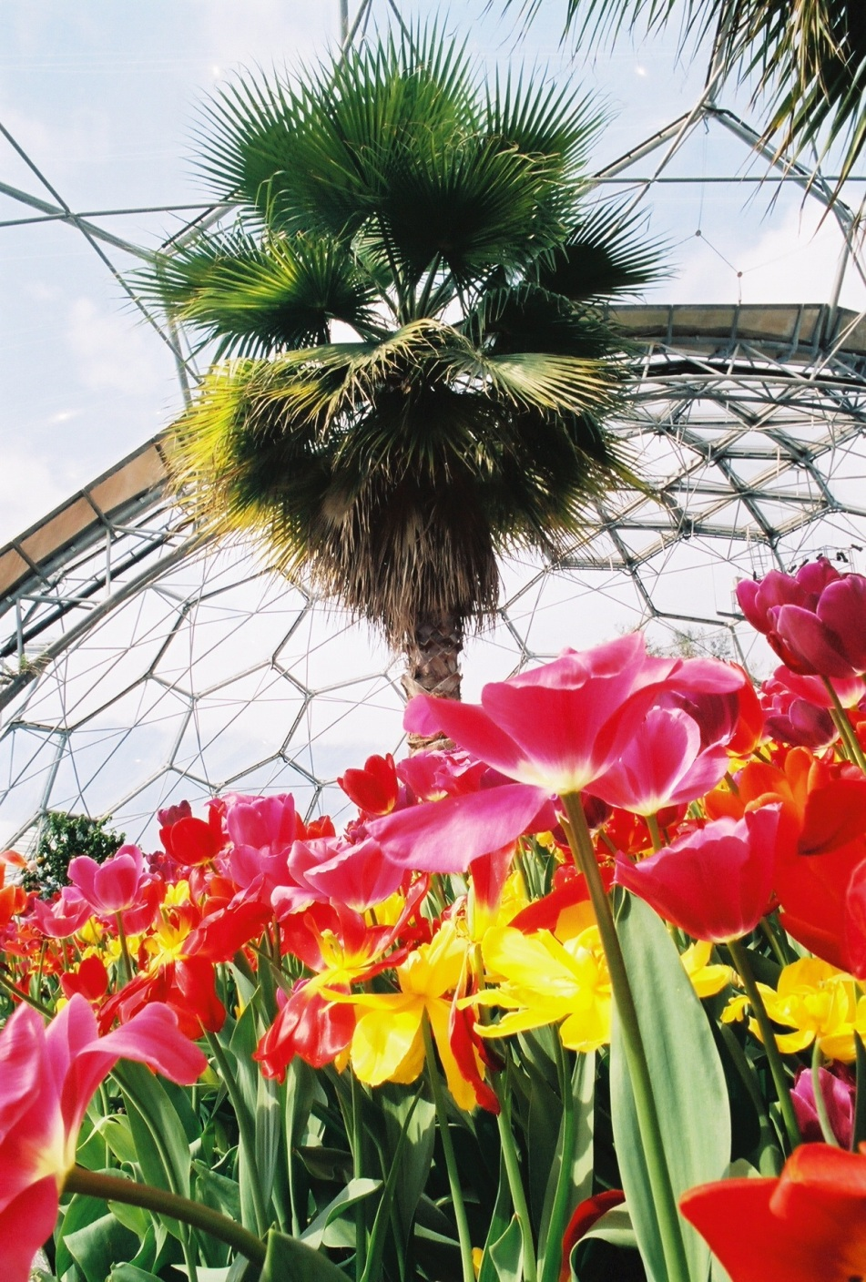
Take more than one photo of the same thing:

Slide 8
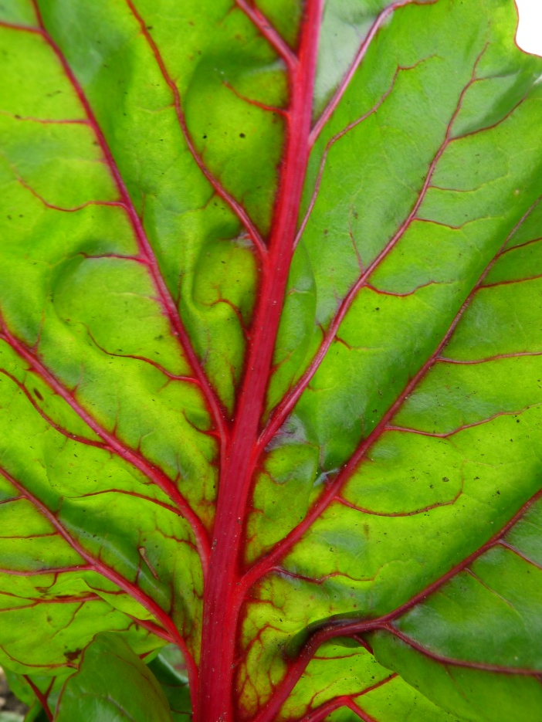
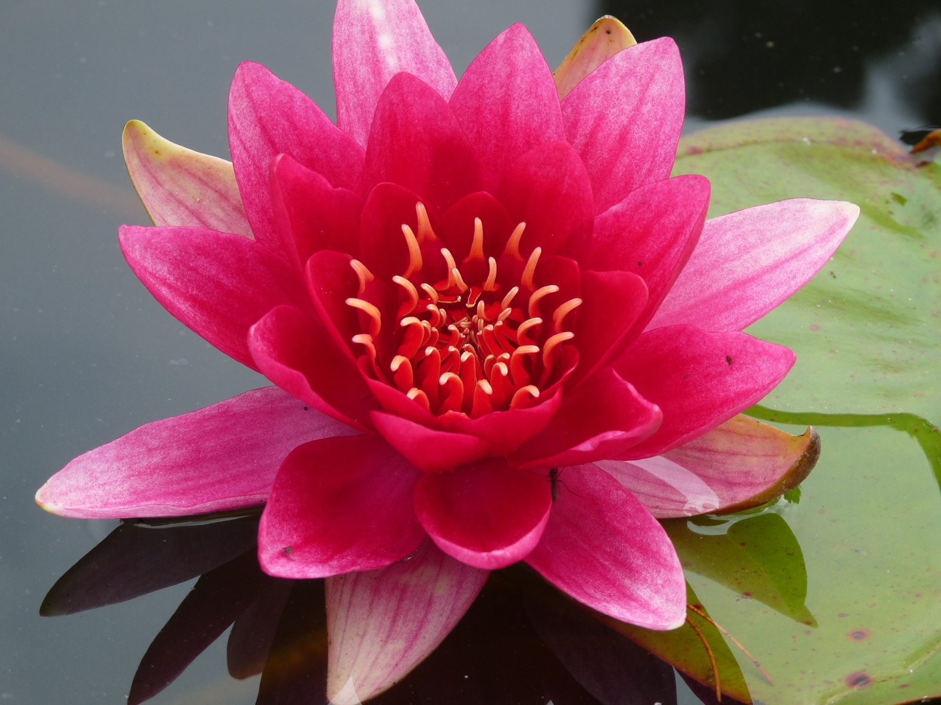

Take photos up close:
This is the symbol for ‘Macro’ - change your camera to this setting to take photos up close.

Slide 9
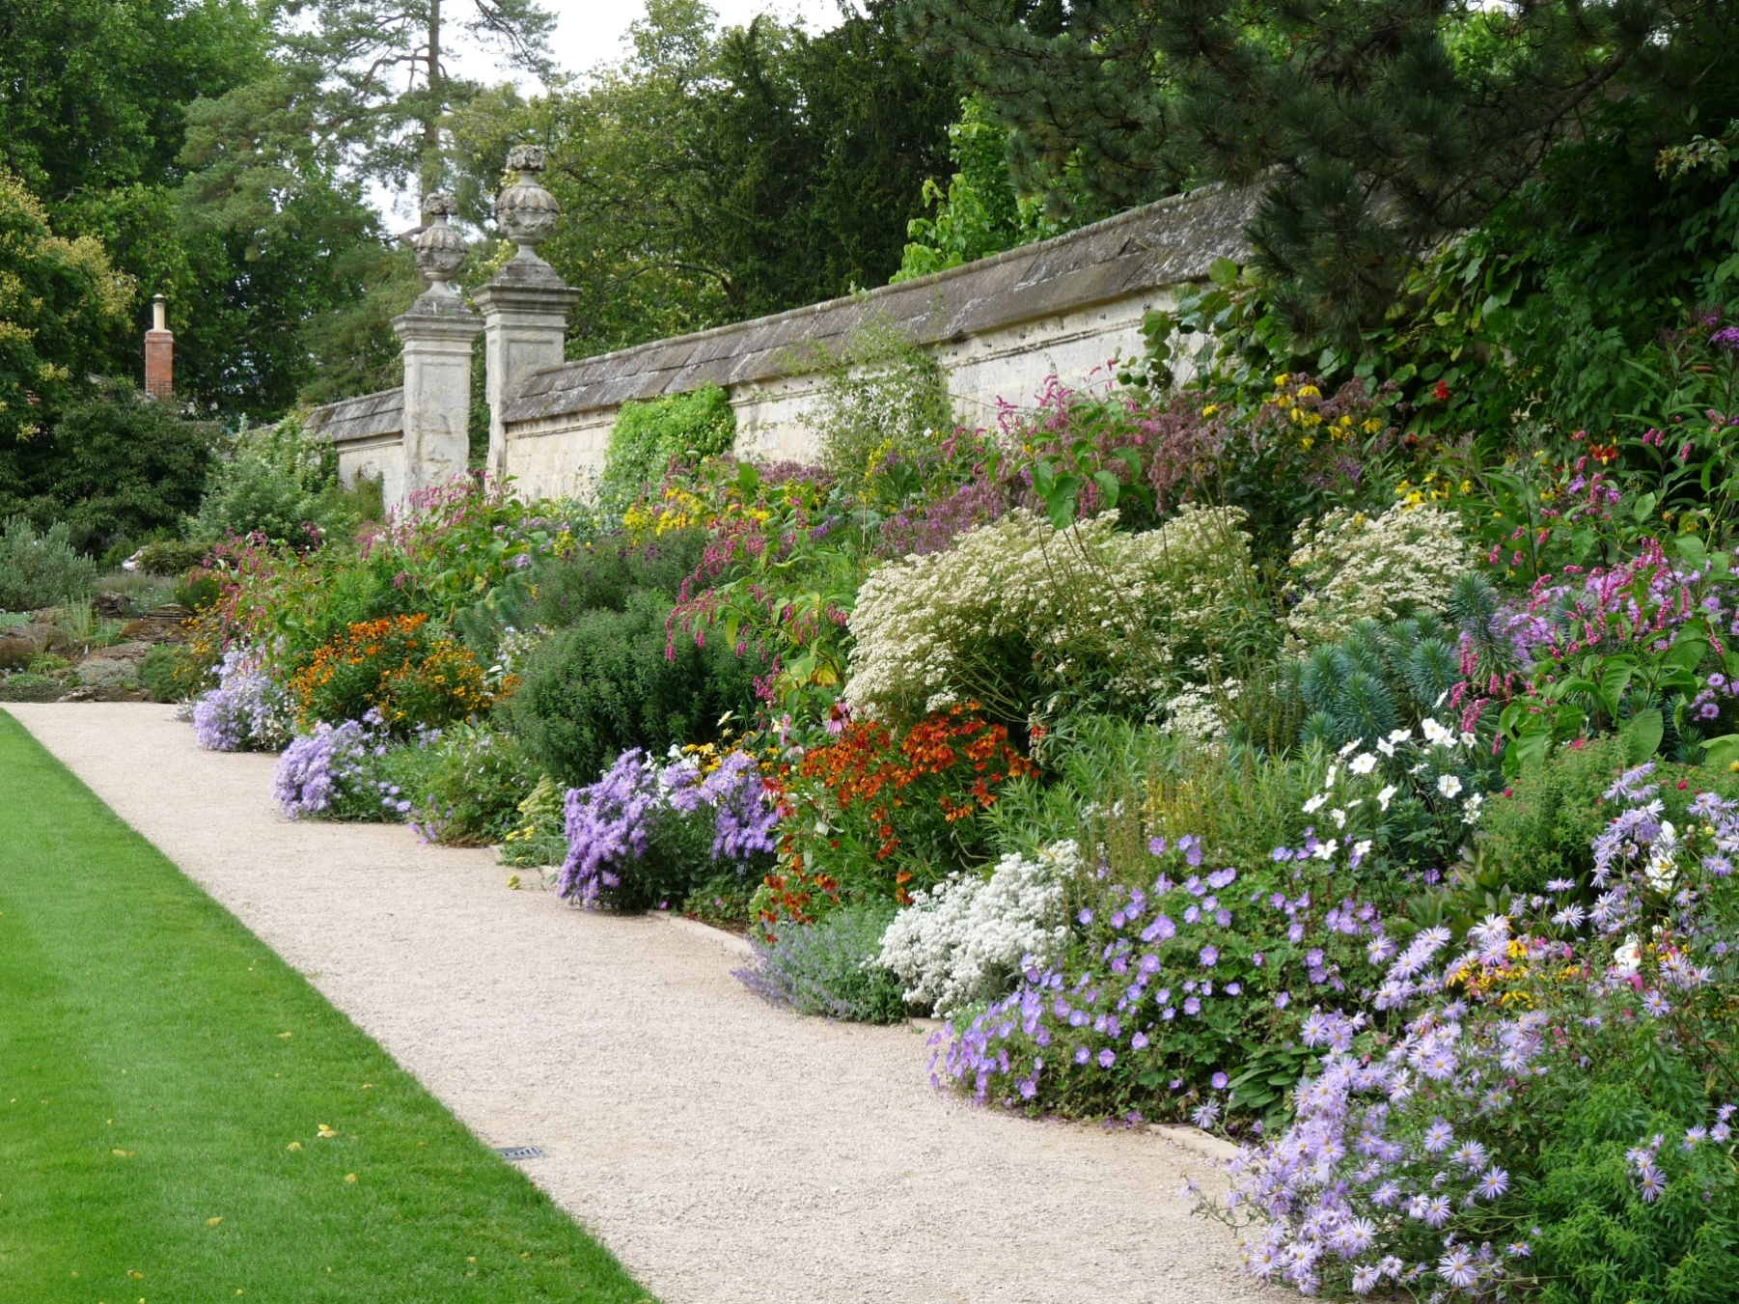
Take photos from further away:

Slide 10


Digital camera settings:
Flash
BE CAREFUL:
The flash can BLEACH out
the colours!
Automatic
Timer
Action
Portrait
Night
Macro
Landscape

Slide 11
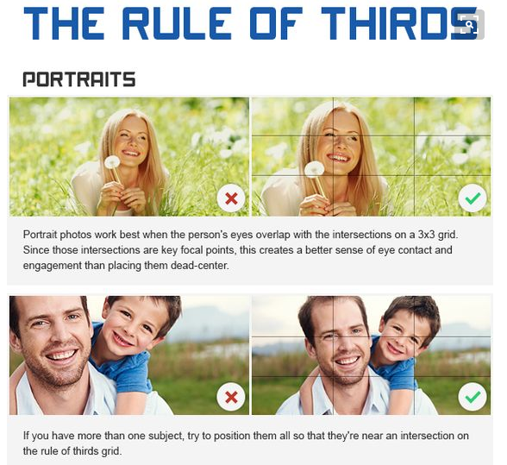

Slide 12
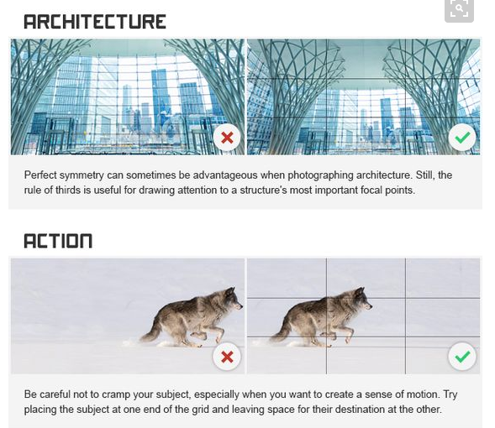

Slide 13
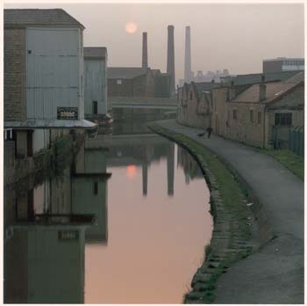
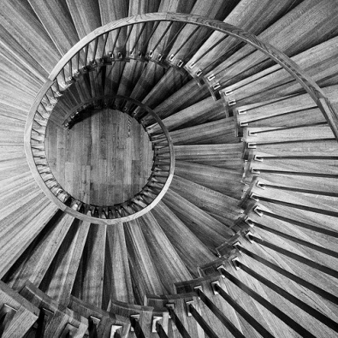
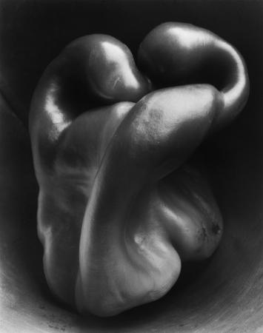
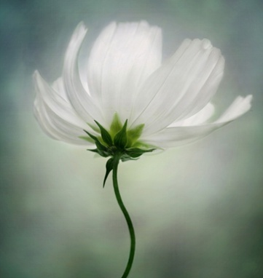
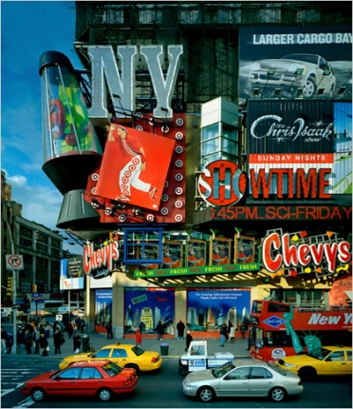

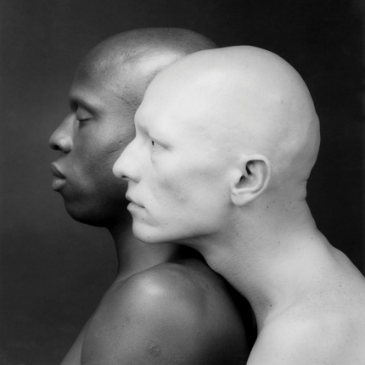
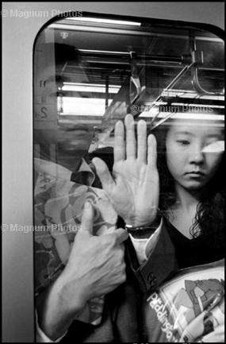
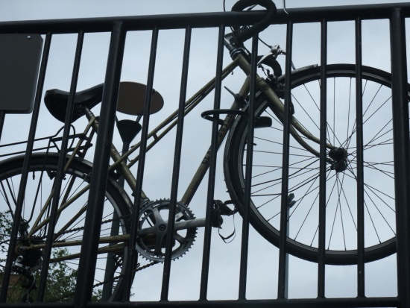
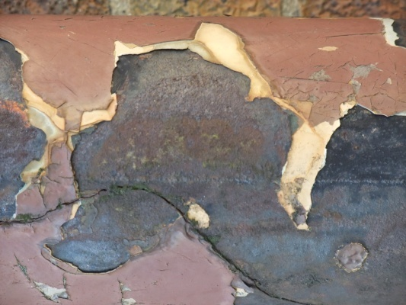
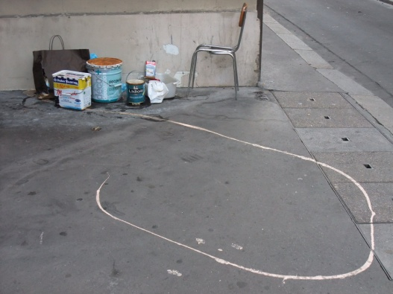
THE SUBJECT MATTER OF PHOTOGRAPHY. GENRES AND CONCEPTS
LANDSCAPE
PORTRAITURE
FIGURE
STILL-LIFE
ABSTRACT
STAGED
CONSTRUCTED
OTHER

Slide 14
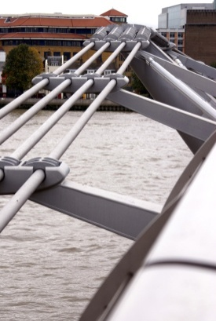
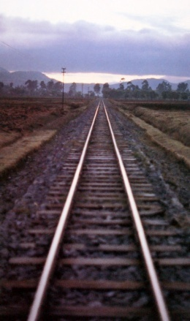
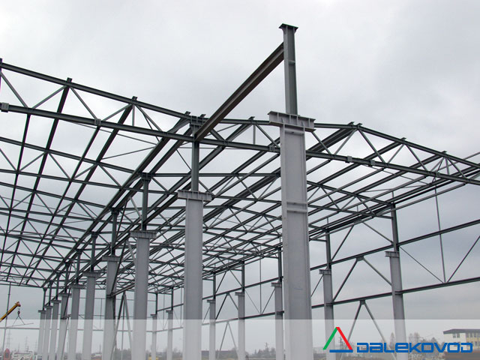
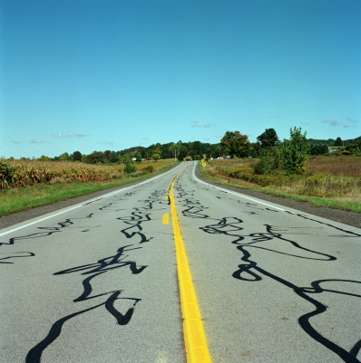
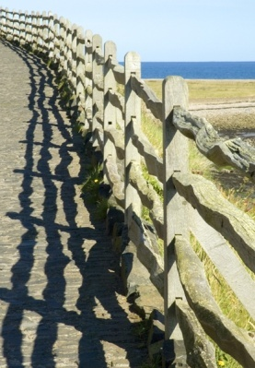
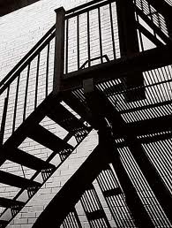
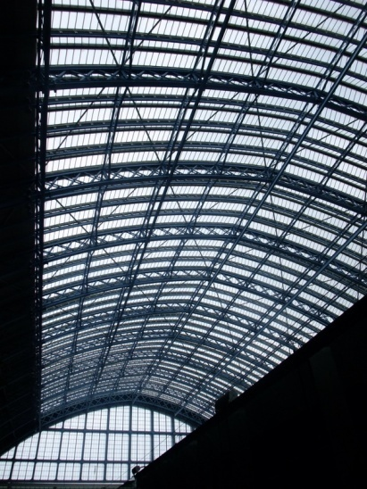
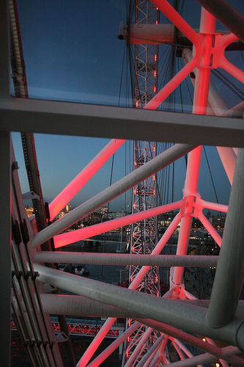
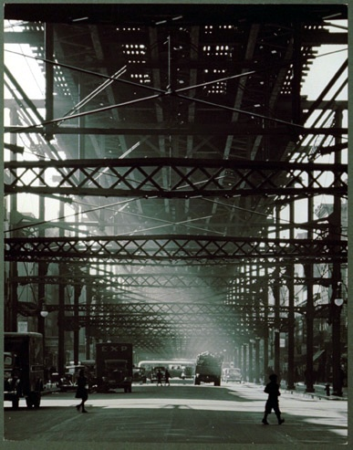
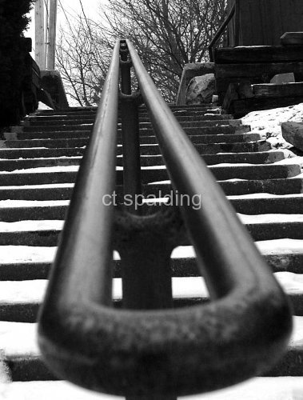
THE VISUAL ELEMENTS -- LINE
Lines are seen in photographs in many ways.We see lines as EDGES of things.We see ‘outlines’ to shapes.We notice that lines appear to lead our eye deep into the photograph.Lines seem to express tension,movement,direction and often create new shapes and patterns.

Slide 15
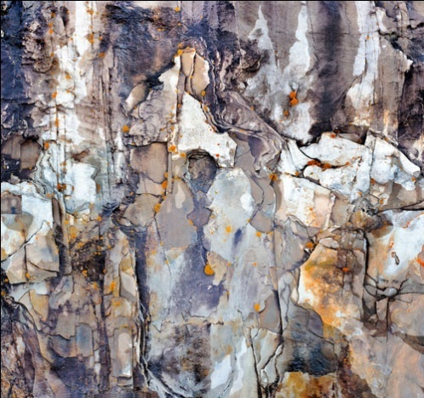
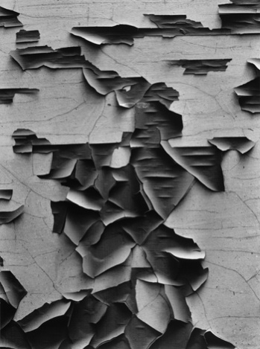
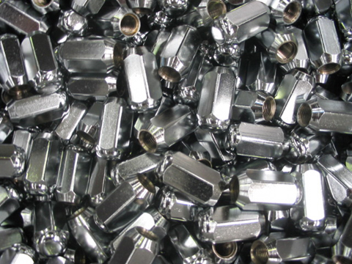
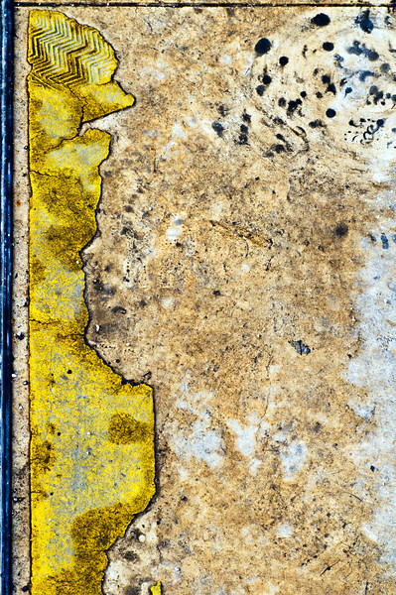
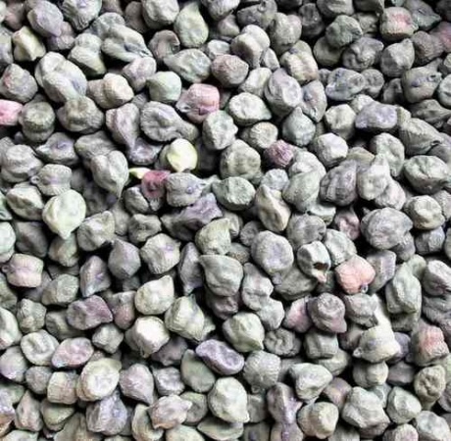

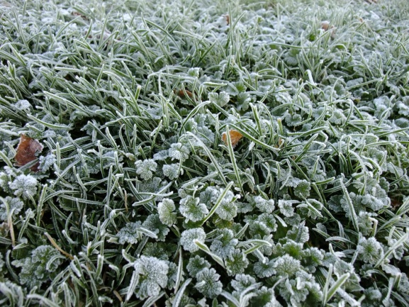
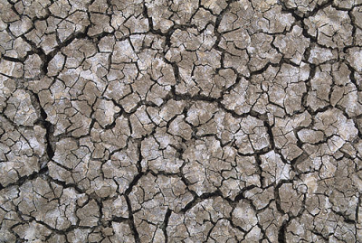
Element - TEXTURE

Slide 16

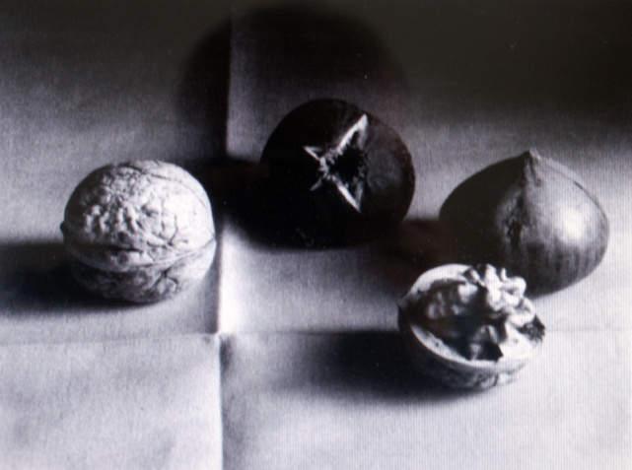
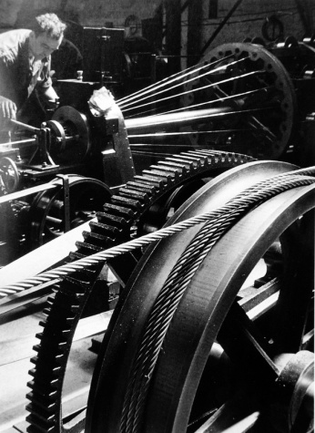
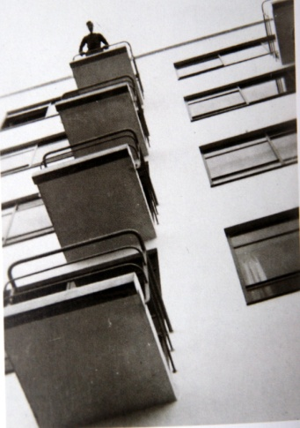
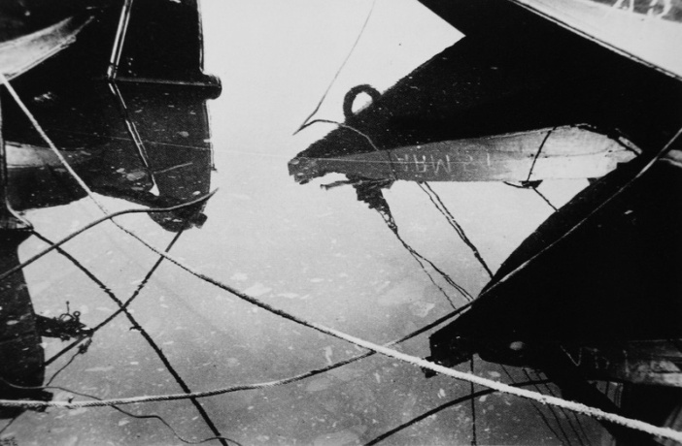
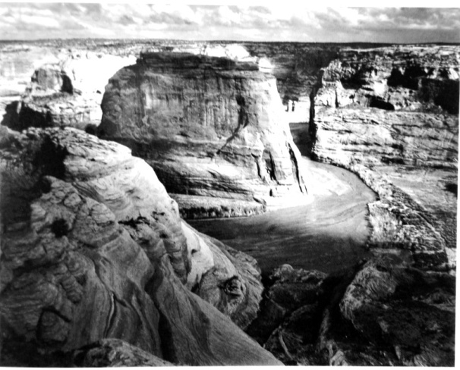
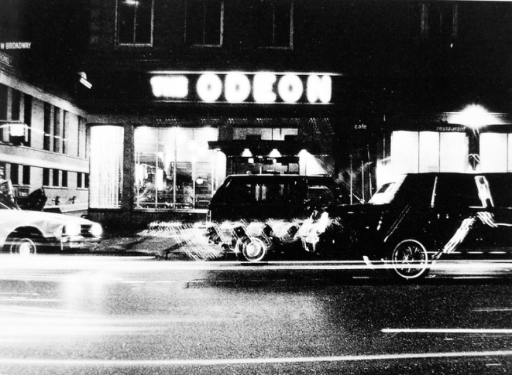
Element-VALUE
In the photograph is there a range of TONES from light to dark? Squint your eyes. Where is the darkest value? Thellightest?

Slide 17
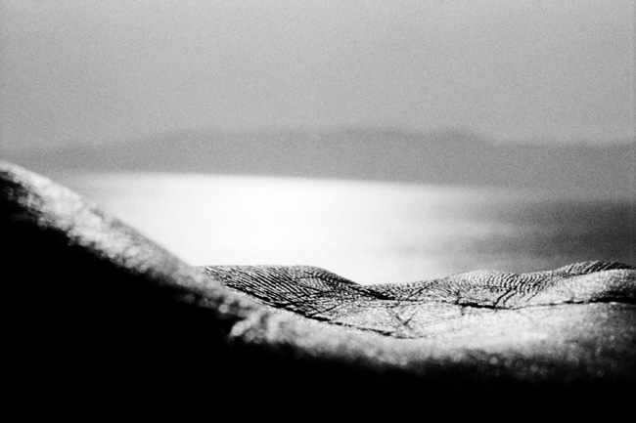
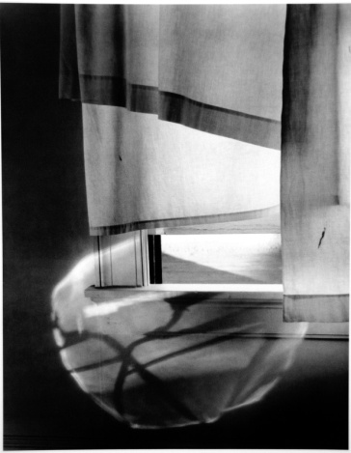




Element- FOCUS
What parts of the image are clearly in focus? Are some parts out of focus? What various effects can be achieved by varying the focus in different areas of a photograph?

Slide 18







Element - SHAPE

Slide 19







Element -Space
We live in real space. Photographs take up space and flattens it onto a piece of paper. How does a photograph appear to show space? Depth, distance, air and light pull our senses into photographic space.

Slide 20







Element- Form
Form is shape seen as three dimensions.Form is clearly seen when light reveals changes of surface and communicates roundness, solidity of objects,people and places.

Slide 21






Element- Colour
Imagine a world without colour. It nourishes our senses and contributes to our sense of being truly alive. Photography is now largely colour photography. Colour photography communicates reality, emotions and stimulates our imagination.

Slide 22
The Task…
You will be taking a range of photographs with a camera or your phone – or both.
Using your knowledge of design elements, you will capture a range of images which link in with each of the 7 following themes.
Using both the editing apps on your phone and Photoshop (or other editing programs you have access to), you will take and edit many photos along the way but will need to choose one final example for each of the headings below and present in an exhibition at the end of term:
  Up Close
  Motion
  Shadows
  Water
  Texture
  Colour
  Emotions

Slide 23
You will need to start collecting images and print/paste into your journal. “Annotate” – make notes against your photos to discuss the things you like, the things that work and the things that could work better.
Before and after shots – Try and have examples in your journal of your photos before you edit e.g.: filter, brightness/contrast, crop etc.
Your main aim in this task is to expand your understanding of photography by practising and exploring the media.

Slide 24
Learning objections: What will I learn?
You will practise techniques and processes to enhance your ideas and art making.
You will analyse how artists use visual conventions in artworks.
You will develop ways of enhancing your intentions as a artist through the explorations of materials, technologies and processes.

Slide 25

Assessment:
CONTENT DESCRIPTORS | A | B | C | D
Develop ways to enhance their intentions as artists through exploration of how artists use materials, techniques, technologies and processes. (ACAVAM119)
Practise techniques and processes to enhance representation of ideas in their art-making (ACAVAM121)
Analyse how artists use visual conventions in artworks (ACAVAM123)

