Slide 1
Abstraction in Photography
This resource is included in TATA’s COVID19 visual art resources collection with appreciation and permission from its creator, Kate Camm, of Elizabeth College Tasmania. TATA does not have ownership of the IP (Intellectual Property) contained within the resources shared on this website. TATA acknowledges the generosity of sharing practice that underpins this collaborative resource sharing space, and ask that any on-sharing of resources acknowledge the originating IP of the Arts/Education professional/s who have contributed this resource, as well as any third party content acknowledged therein
April 10th, 2020 Courtesy of Miriam Berkery, The Friends School, https://tata.org.au/

Slide 2
What is it?
Essentially abstraction is a section of something. It is taken out of context and you are unable to see what is happening around it
A well composed abstract image should have no orientation. Meaning you can turn it upside down or back to front and it still makes sense
An abstracted image often focusses in on colour, shape form or texture
Abstract photography often only captures a fraction of a subject

Slide 3
The History of Abstraction in Photography
Abstraction can actually be traced back to Minimalism
This was an art movement that began in New York in the early 1960s
This movement valued the anonymity over expression
These artists avoided symbolism or emotion, paying more attention to materiality
This movement began with sculpture but can now be seen in all areas of life from architecture to fashion, film and even cooking

Slide 4
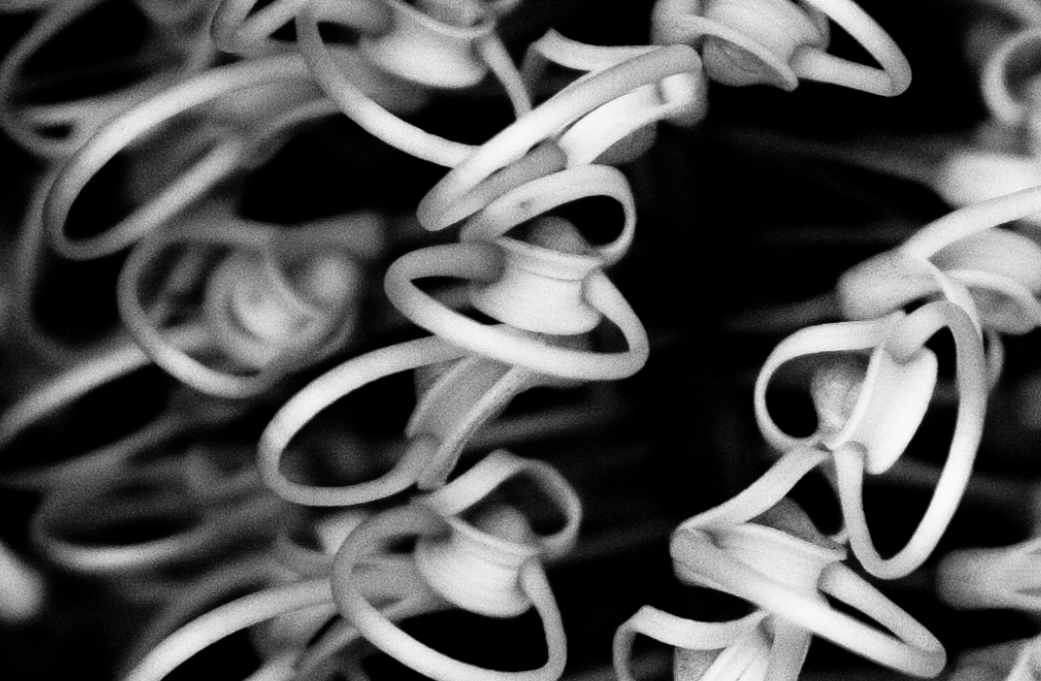
The Difference between Abstraction and Minimalism
If you can tell what the image is of it is minimalism.
If you are unsure what the image is of, it is Abstraction
Minimalism
Abstraction

Slide 5
Mondrian’s Trees
Click on the image to watch this video
https://www.youtube.com/watch?v=1x8m-7N-Kjo

Slide 6
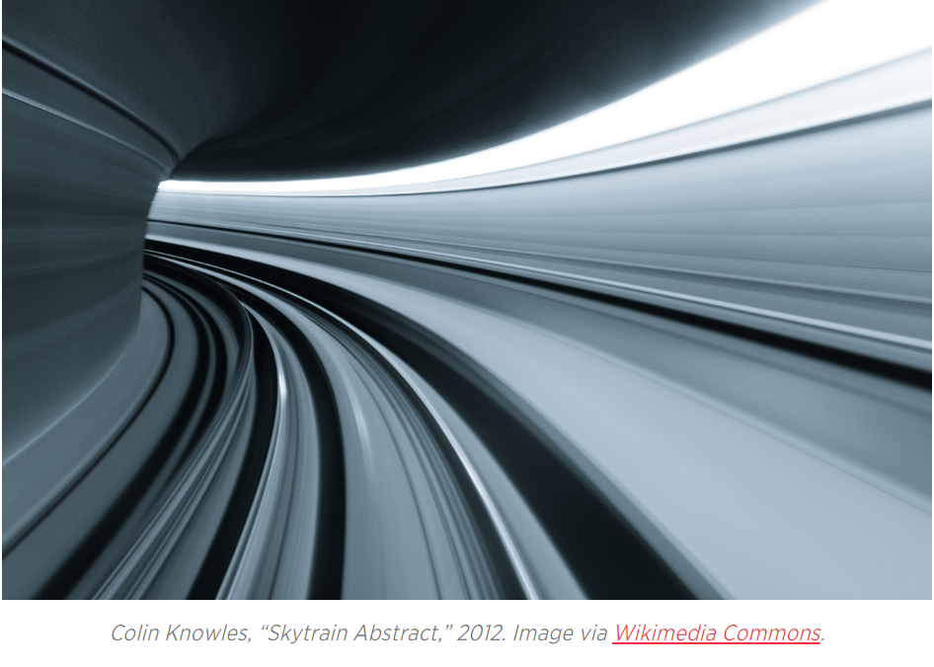
Lighting
You can utilize shadow and backlighting
Also play around with the direction of your light, does it make lines or shapes?
Don’t use lighting to highlight your subject but rather allow it to create alements you wish to photograph

Slide 7
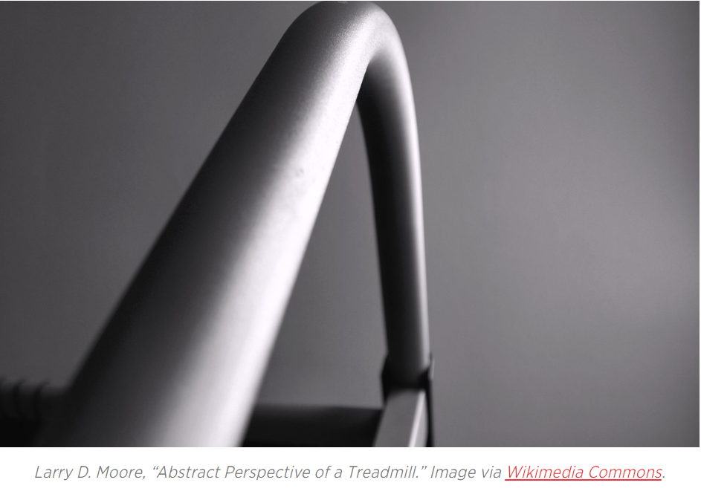
Simplicity
The idea of abstraction is to pair back an image to it’s basic parts.
Try to remove any distractions you can do this by removing elements that might trigger emotion in your audience such as colour.
Focus on clean uncluttered design

Slide 8
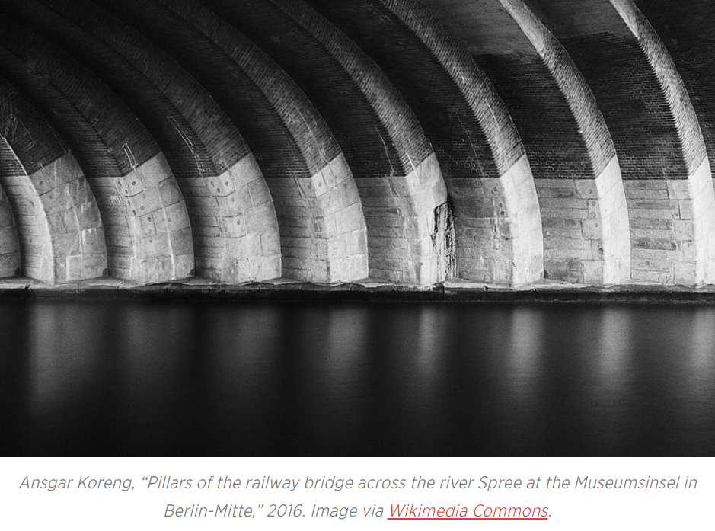
Composition
Balance can really help with abstract photography
Consider how shape, line and form can help to structure your images
The rule of thirds still applies, do do all of your other composition techniques

Slide 9
Movement
Don’t be afraid to move your camera, it might create an interesting blur
You could move your camera up towards the sky or down towards the ground to help you remove distractions from your shots

Slide 10
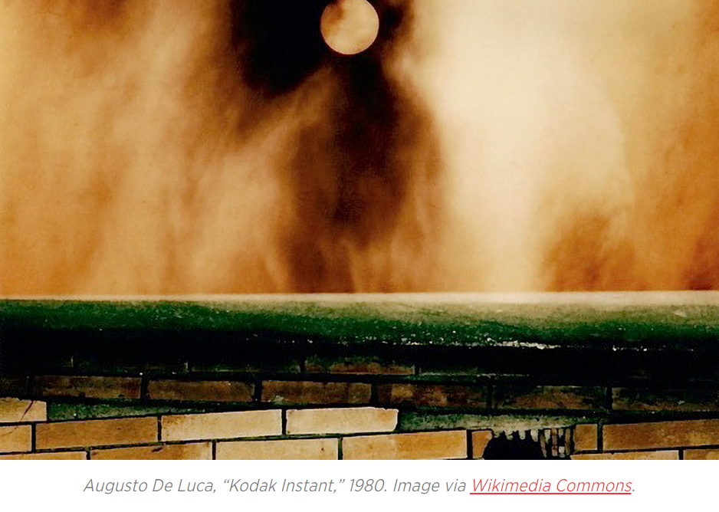
Intrigue
Remember the goal is for your viewer to not know where it was taken, what it was of or how you got it. Intrigue them- make them think!

Slide 11
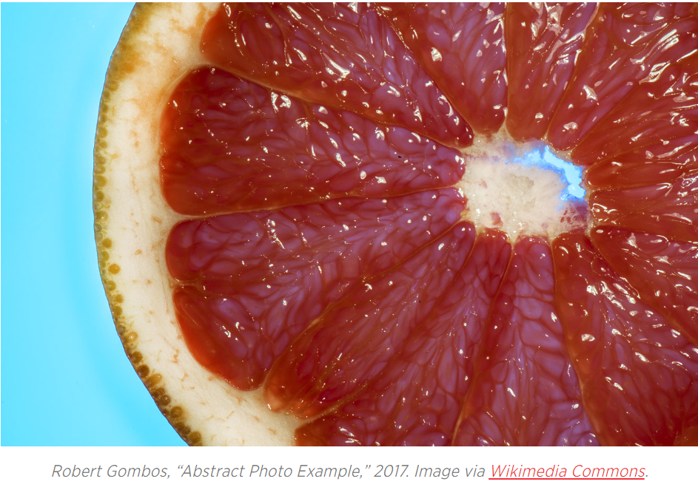
Distance
Moving close to a subject might reveal elements you hadn’t noticed before
Similarly moving away from a subject can distort perception and play around with scale

Slide 12
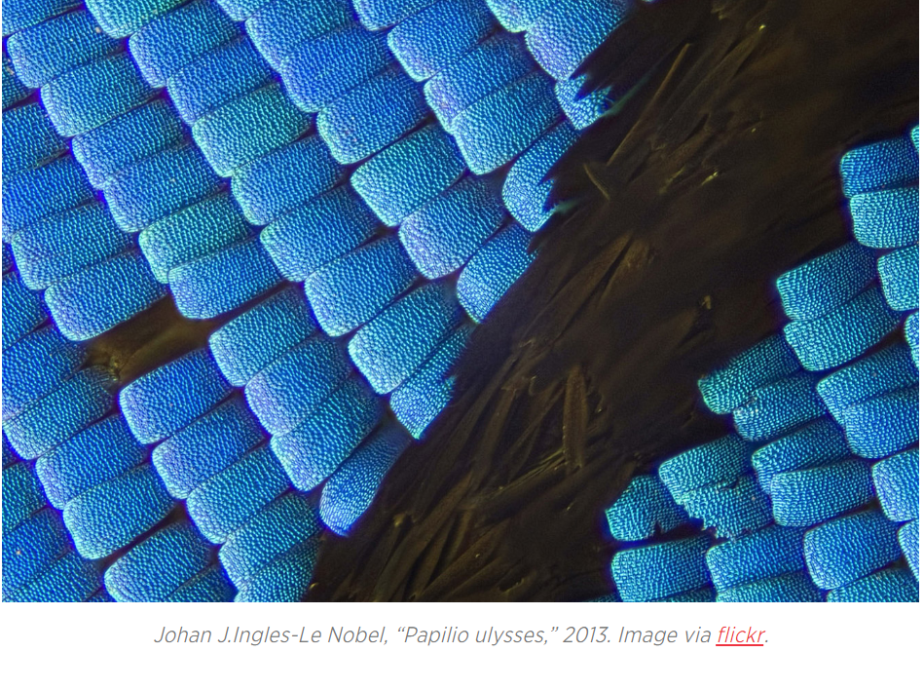
Texture
Different textures often have within them patterns. Whether it be a knitted sweater or the inside of an orange, showing and exploring different textures will help you to discover new elements which are interesting

Slide 13
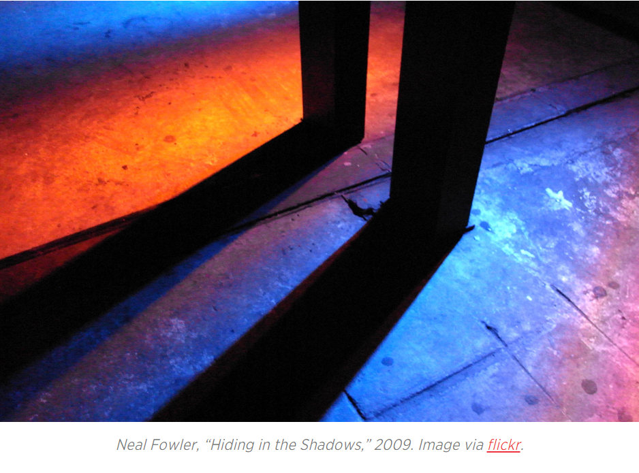
Flash
Experiment with having your flash on or use a torch or a lamp if you don’t have a flash. How does intense light blow out shadow and depth? What does this reveal?

Slide 14
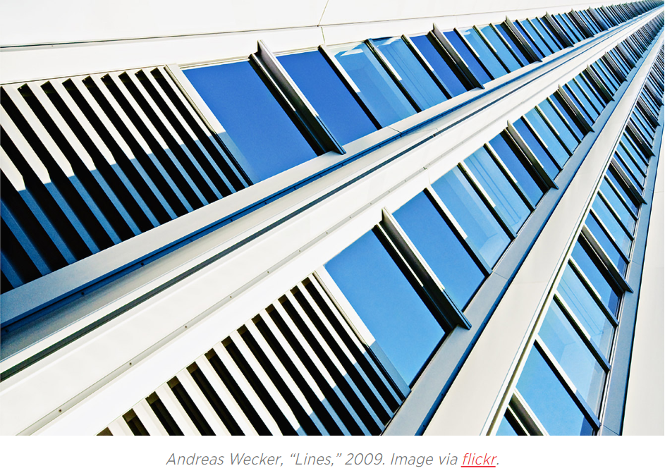
The Every Day
Consider every day objects. Often things you use in your every day life are interesting such as kitchen utensils, foods, pets, yourself! You don’t need to visit a foreign country to access interesting subjects

Slide 15
Your Challenge
Shoot a minimum of 30 images
Play around with the techniques in this PowerPoint as well as some of the techniques you have already learnt this year
Experiment with shooting in Monochrome, standard and different White Balance settings
Send Kate your favourite x5 images
In your journal find x2 abstract artists whose work you like, including images of their work and a bit about the artist and why you like their work?

Slide 16
Extension Work
Research the artist Frank Stella
Research his work and practice. Pay attention to his image Die Fahne Hoch! (1959)
Include this research in your journal and ask yourself the question: what was the artist’s intention for making this work? Were they successful? Record your answer in your journal and try to be persuasive
Create an image featuring just 1 element. Choose either colour, shape or line. Only one element can feature, throw away everything else!
https://whitney.org/WatchAndListen/1267

