Slide 1
Composition
This resource is included in TATA’s COVID19 visual art resources collection with appreciation and permission from its creator, Kate Camm, of Elizabeth College Tasmania. TATA does not have ownership of the IP (Intellectual Property) contained within the resources shared on this website. TATA acknowledges the generosity of sharing practice that underpins this collaborative resource sharing space, and ask that any on-sharing of resources acknowledge the originating IP of the Arts/Education professional/s who have contributed this resource, as well as any third party content acknowledged therein
April 10th, 2020 Courtesy of Miriam Berkery, The Friends School, https://tata.org.au/

Slide 2
Why is it important??
It can help you to convey a story to your viewer. Your images should be well composed and the viewer should not have to work hard to see a strong image.

Slide 3
For this task shoot with a display grid on your screen to help you compose your images.

Slide 4
Rule of Thirds
Rule of thirds suggests you dived your image into 3 sections evenly, horizontally and vertically. And place your subject in any of the 4 intersecting points. The human brain automatically looks in these areas, making it easy for your viewer to see the main subject and pay attention to it. This is a much more dynamic way of presenting your subject matter than simply placing it in the centre of your image.

Slide 5
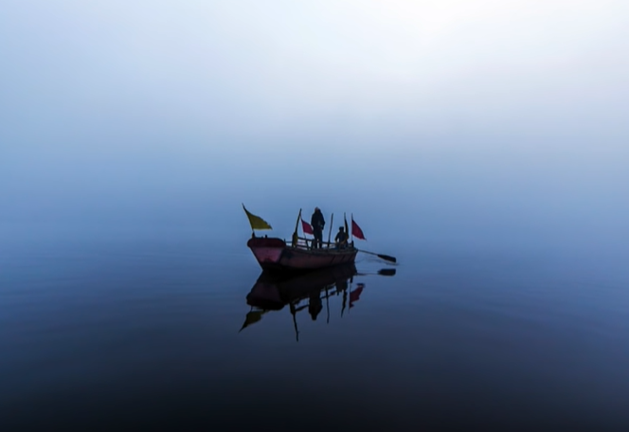
Centre Composition
When using Centre Composition you need to be very aware to balance the left and right of your image and the top and bottom. This technique works well when you have symmetry in your scene or you want to play around with reflection. Don’t be scared of simplicity with this technique.

Slide 6
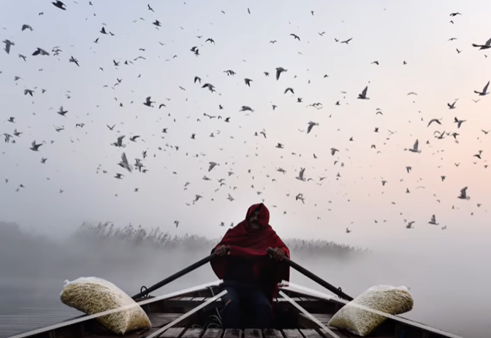
Leading Lines
This is when your image naturally has lines that lead you to a single point/ or your subject. These lines are not always straight.

Slide 7
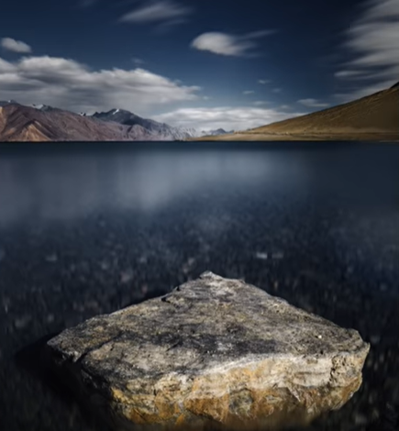
Foreground Interest
When shooting the foreground is often forgotten and the mid-ground and background are focussed on. Try including a subject in the foreground that compliments your image. This technique can help lead the viewers eye through the image.

Slide 8
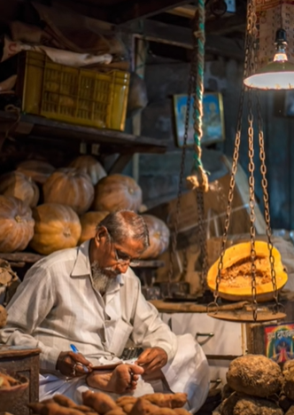
Focal Length
As you zoom in on your subject the background of your image starts compressing. If you are shooting a landscape you may want a wide lens to make sure everything in your shot is in focus. When shooting portraits you may want to zoom in on your subject to blur the background and only have the figure in focus. Another way to think of this is to use a wide aperture to blur your background and a small aperture to focus everything. Remember the smaller the number the bigger the aperture.

Slide 9
Experiment
Spend some time playing with interesting composition. Build a bank of photos you can access from home.

