Slide 1
Using Watercolours
This resource is included in TATA’s COVID19 visual art resources collection with appreciation and permission from its creator, Kate Camm, from Elizabeth College,, Tasmania. TATA does not have ownership of the IP (Intellectual Property) contained within the resources shared on this website. TATA acknowledges the generosity of sharing practice that underpins this collaborative resource sharing space, and ask that any on-sharing of resources acknowledge the originating IP of the Arts/Education professional/s who have contributed this resource, as well as any third party content acknowledged therein
April 10th, 2020 Courtesy of Kate Camm, Elizabeth College, https://tata.org.au/

Slide 2
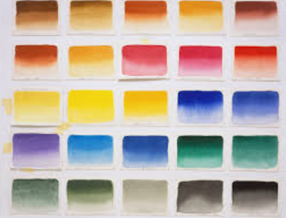
Rule your page into 12 even sections
Write the title of each technique at the bottom of the square and fill each square with a different one of the following techniques

Slide 3
Always build light to dark
Because watercolour doesn’t have any body you must put your lightest colour down first and then build up to the darker colours

Slide 4
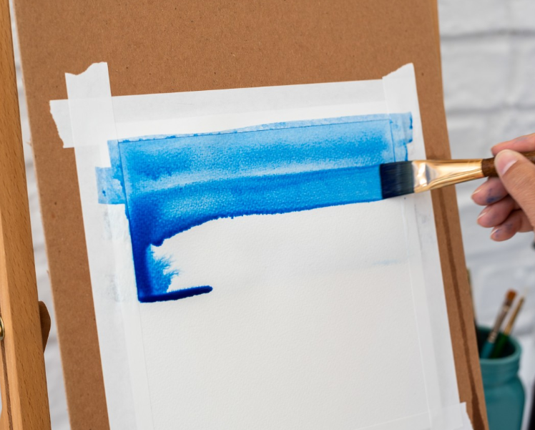
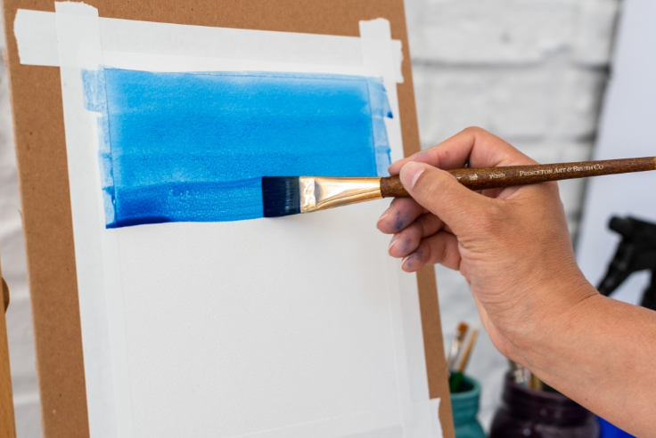
Washes
Dry Wash
Paint onto a dry surface
Wet Wash
Paint onto a wet surface

Slide 5
Wet in wet
Put a very wet brush with paint onto a very wet surface. Use your brush to make different marks

Slide 6
Layering
Choose one colour
Get a piece of fruit or a vegetable
Put down a very light shade of the general shape of the fruit/vegetable
Make your paint a little darker/more intense and paint some of the middle range shadows you see on your object
Now with the darkest most intense version of your colour put down the darkest parts you see on your object

Slide 7
Dry Brush
Paint a dry brush with paint onto a dry surface

Slide 8
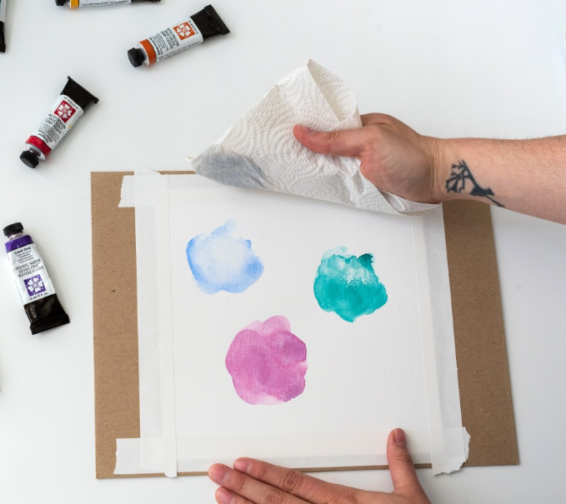
Lifting Colour
Paint another section and while it is still wet dab parts off with paper towel
Paint a small section, wait for it to dry and rub parts off with an eraser

Slide 9
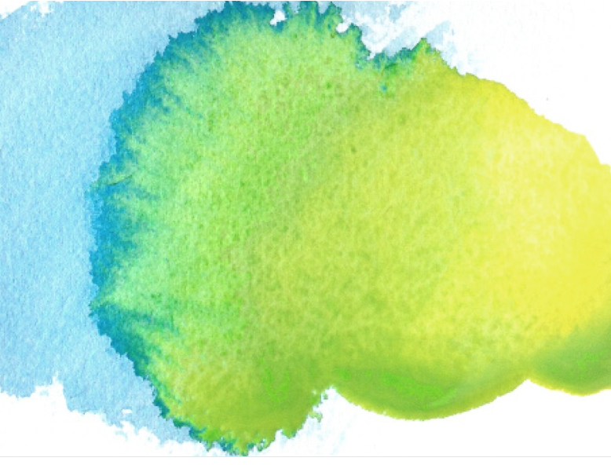
Blooms
Put down some clean water onto your page. Put some intense paint onto your brush and dip very carefully into the water on your page. See how the water takes the paint from your brush to make these blooms

Slide 10
Feathering
Onto a dry surface with a wet brush and slight paint use a wider brush to make feathering

Slide 11
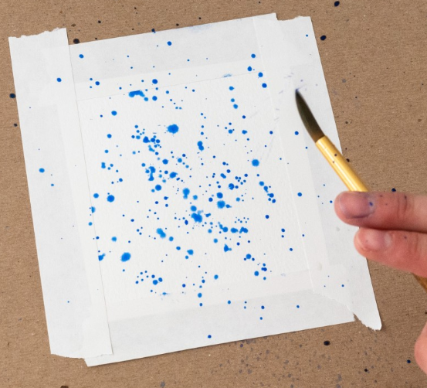
Splattering
Tap- hit your brush against one of your fingers towards your page
Flick- use your finger to flick the bristles of your brush towards your page

Slide 12
Salt lifting
Paint a section onto your page. Put some salt onto this section. Wait a few minutes and see the salt suck the paint and water up leaving an interesting pattern. Thicker salt works best

Slide 13
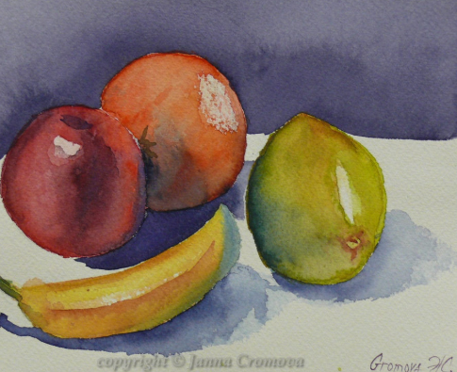
Create an A4 painting
Now make an arrangement of fruit and vegetables or other natural materials (flowers, plants, leaves etc). Use the techniques you’ve just learnt to paint the arrangement.
Don’t forget to put the lightest colours down first and build up to the darker colours.
Make sure you put the shadows cast by your objects in too

